Slide 1
Chapter 12: Ecology
Biology
Waggy

Slide 2
CHAPTER 12 LEARNING OBJECTIVES
1. Define Ecology
2. Trace energy through ecosystems (food chains & food webs)
3. Biotic (living) portion of an ecosystem: Species interactions
4. Abiotic (non-living) portion of an ecosystem: Biogeochemical cycles

Slide 3
LEARNING OBJECTIVE
1. Define Ecology

Slide 4
What is Ecology??
The study of interactions that take place between organisms and their environment.
There are three parts to the environment:
  1. Energy Transfers (food chains)
  2. Biotic factors- all the living organisms that inhabit an environment.
  3. Abiotic factors-Non-living parts of an organism’s environment.

Slide 5
LEARNING OBJECTIVE
2. Trace energy through ecosystems (food chains & food webs)

Slide 6
Energy Flow
Energy in an ecosystem originally comes from the SUN
  Energy flows through Ecosystems from producers to consumers through a Food Chain or Food Web

Slide 7

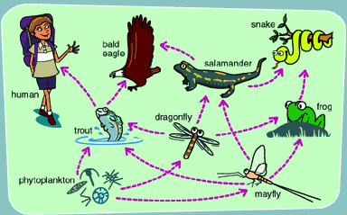
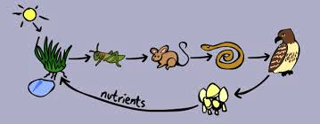
Energy Flow
  Energy flows through an ecosystem in ONE direction from producers to consumers & ending with decomposers

Slide 8
Producers
(autotrophs)
  producers make own food

Slide 9
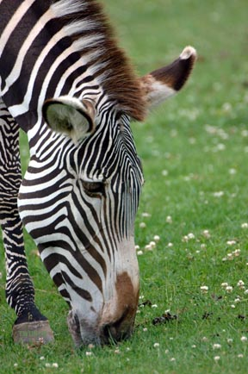
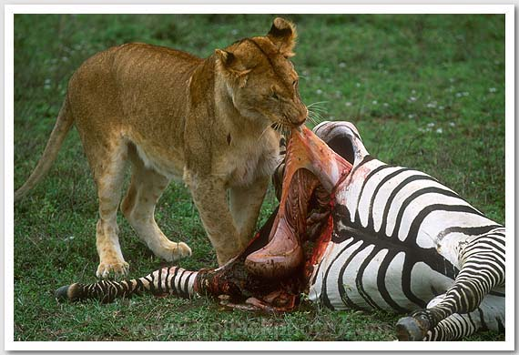
Consumers
(Heterotrophs)
Consumers must eat other organisms to get energy
Herbivores
  Eat Only plants
Carnivores
  Eat Only Other animals

Slide 10
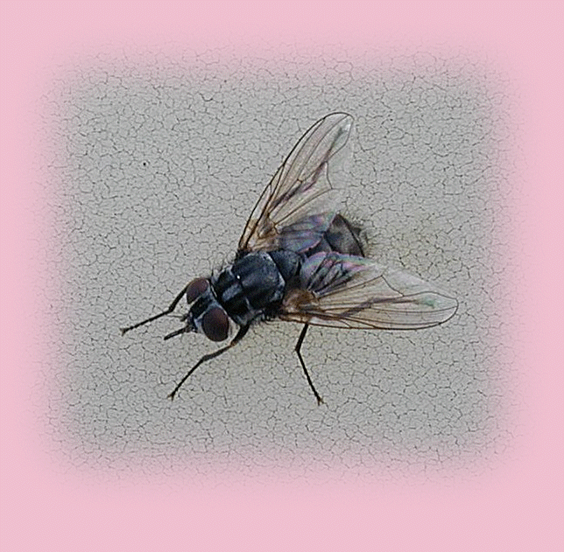
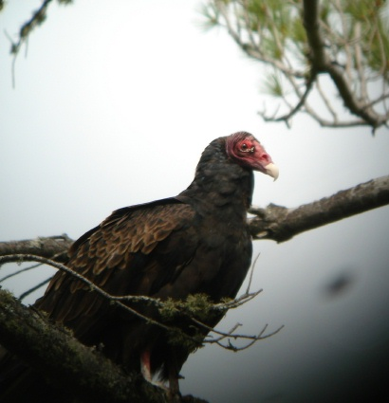
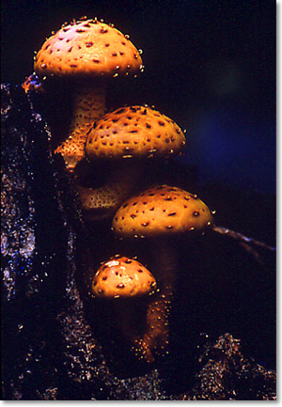
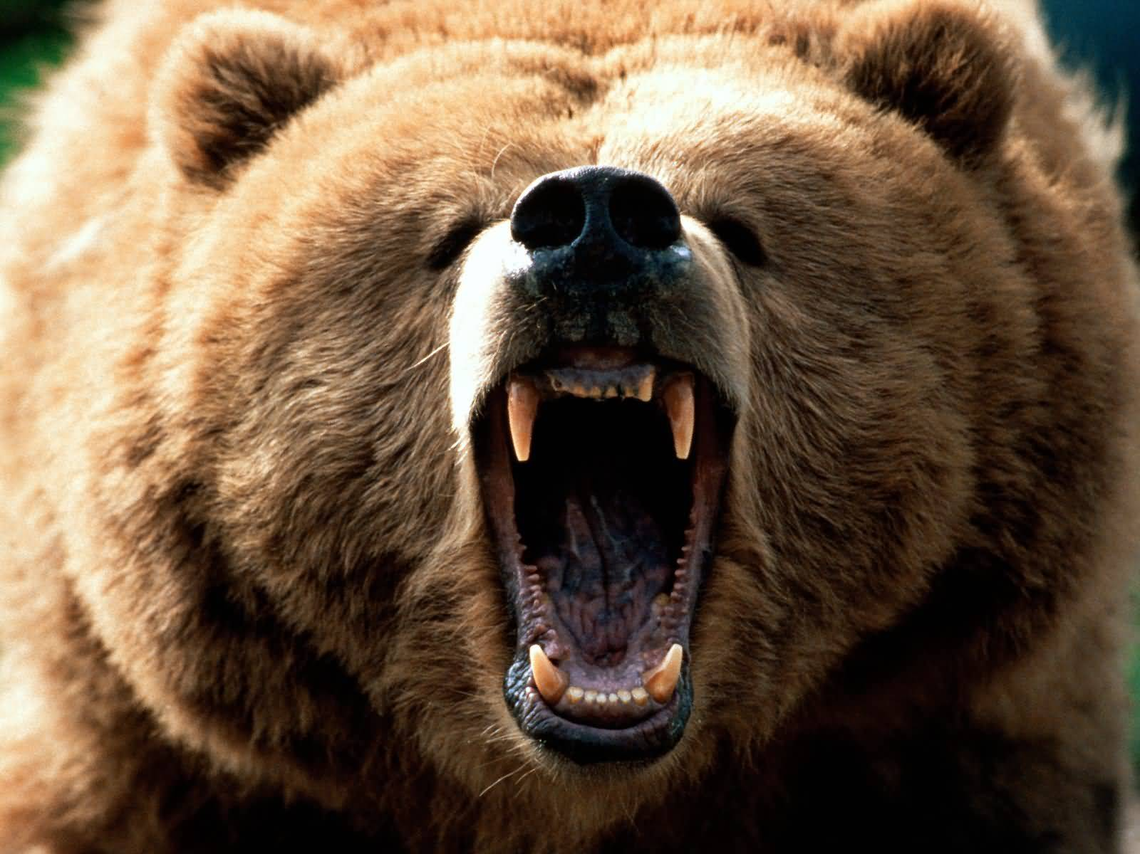
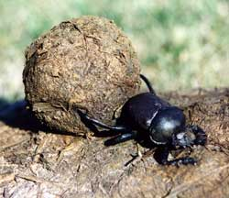
Omnivores
  Eat Plants & Animals
Detritivores
Feed On Dead Plant & Animal Remains (detritus)
Decomposers
  Return chemicals to the Earth/soil to be reused (Fungi & Bacteria)

Slide 11
Interactions between members of a food chain or web can affect the population numbers of different species
If the predator numbers get too high, there will not be enough food and then they will starve, lowering their numbers
Each level of the food chain depends upon the level below it for survival

Slide 12
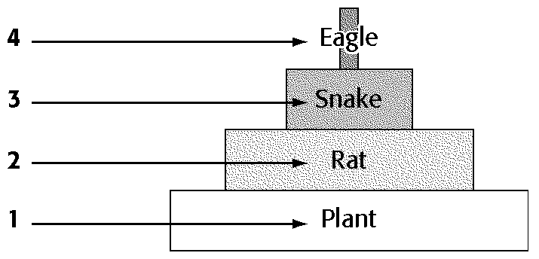
Population growth happens when:
  1. Predator numbers are low
  2. Prey animals are healthy (no diseases)
  3. There is plenty of food resources

Slide 13
