Slide 1
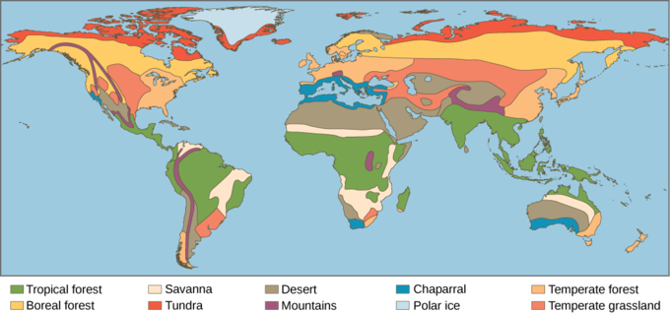
Chapter 13 Ecological Biomes
Waggy
Biology

Slide 2
Chapter Objectives
1. Define the different levels of life on Earth
2. Differentiate between the Six Land Biomes
3. Differentiate between the Water Biomes

Slide 3
LEARNING Objective
1. Define the different levels of life on Earth

Slide 4
Life has found a way to survive in some of the harshest conditions Earth has to offer
Scientists has named these areas from large to small – much like in taxonomy
Biosphere – the zone of life on Earth
Extends from the deepest parts of the ocean to the highest layer of the atmosphere
Biome - a collection of all the ecosystems in an area

Slide 5
Ecosystem – all the living an nonliving parts of an environment
A pond, garden, water puddle and riverbanks are all examples of ecosystems
Community – includes all the living things found in an ecosystem
Each community is made up of many different species living together.
Population – a group of the same species living in the same area

Slide 6
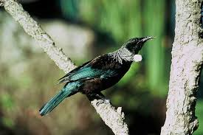
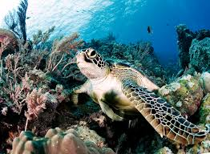
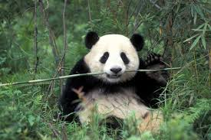
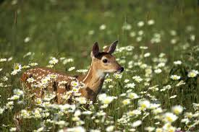
Habitat – a place where an individual organism lives
Niche – the role that organism plays in the community

Slide 7
LEARNING Objective
2. Differentiate between the Six Land Biomes

Slide 8
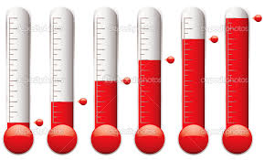
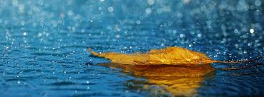
Biomes are identified by their dominant plant life because food chains/webs depend on plants
Two factors that determine what type of plants you find are:
1. rainfall
2. temperature

Slide 9
The 6 Land Biomes
1. Tundra: treeless biome located near the North pole
Temperature: very low (ave: 20 F)
Rainfall: 6-10 in/year- mostly snow that never melts
Winters are very long & cold with little to no daylight.
Summers are short (4 weeks) and cold with 24 hours of daylight
Only the top few inches of soil thaw in the summer – the rest is permanently frozen (permafrost)

Slide 10
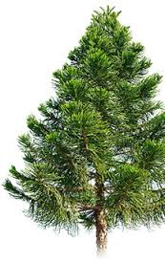
2. Coniferous Forests: located just south of the tundra (sometimes called: taiga)
Temperature: 20 degrees
Rainfall: 20 in/year
Trees are mostly cone bearing trees like spruce and pines
Winters: long and cold
Summers: short and cool

Slide 11
3. Deciduous Forest: located just south of the coniferous forest regions
Trees here lose their leaves in the fall
Temperature: 50 F average
Rainfall: 30-60 in/year
Winters are cold and last about 6 months
Summers are fairly warm and last about 6 months

Slide 12
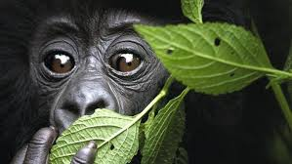
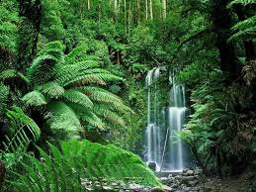
4. Tropical Rain Forests: found near the equator
Temperature: 88 F average with 90% humidity
Rainfall: at least 100 in / year
Winter: none
Summer: hot and humid year round
Has two seasons: wet and dry
Most diverse biome on Land

Slide 13
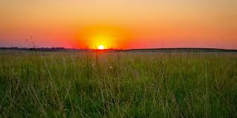
5. Grasslands: found in the centers of continents
Temperature: wide range from winter to summer but averages 70F
Rainfall: 20 in/year
Winters: cold and lots of snow and wind
Summer: hot and dry with wind

Slide 14
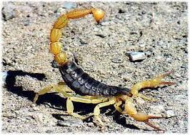
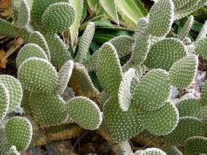
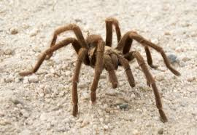
6. Deserts: there are two types: Hot & Cold
found in the interior portion of continents there are two types Hot deserts and Cold deserts.
Hot Desert: Temperature: 98 F average
Rainfall: less than 20 in/year
Cold Desert: Temperature: 60F average
Rainfall: 6-10 in/yr
Plants and animals that live in deserts have adapted to conserve water very well

Slide 15
LEARNING Objective
3. Differentiate between the Water Biomes

Slide 16
Marine (Saltwater) Biomes
There are three Marine Biomes. Salt water covers 70% of Earth’s surface making this the largest biome on earth.
1. Ocean: the most diverse water biome
2. Intertidal zones: exposed during low tides but covered in water during high tide
3. Estuary: where marine water mixes with freshwater – usually at the mouths of rivers

Slide 17
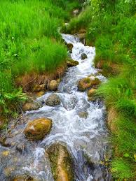
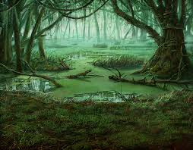
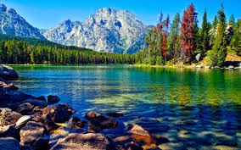
Freshwater Biomes
Freshwater Biomes are determined by the movement of water (or lack of movement)
Still water: no current (lakes, ponds, swamps)
Running water: current is present (rivers and streams)

