Slide 1
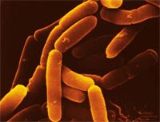
Bacteria
Chapter 15
Biology
Waggy

Slide 2
Chapter Objectives
1. Domain Archea, Kingdom Archeabacteria
2. Domain Eubacteria, Kingdom Bacteria
3. Describe how bacteria can cause disease & what diseases they cause
4. Discuss the different ways of reproduction in prokaryotes

Slide 3
Chapter Objective:
1. Domain Archea
Kingdom Archeabacteria

Slide 4
Prokaryotes
Prokaryotes are very primitive single celled organisms without a membrane bound nucleus
They live EVERYWHERE on earth!!
Through genetic studies, scientists have found that there are two types of prokaryotes
They are placed into two different domains:
1. Archaea - very ancient bacteria
2. Eubacteria - more modern bacteria

Slide 5
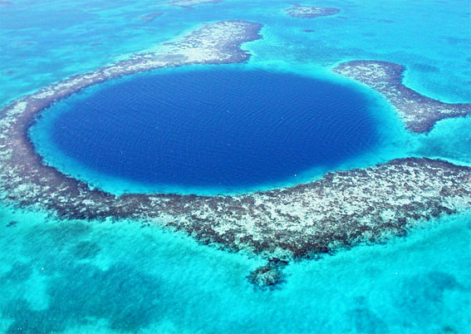
Domain: Archaea
In the Kingdom Archaeabacteria, there are three Phyla of archeabacteria and are chemotrophic (make food from chemicals)
1. Methanogens: make methane
Are found in environments that do not have oxygen like thick mud, deep oceans & lakes, & sewage treatment plants
They live in cows intestinal tracts, which is why a cow can belch up 200-400 ml of methane everyday

Slide 6
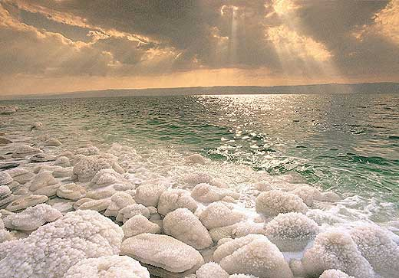
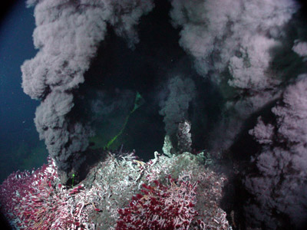
2. Halophiles: “salt lovers”
Are found only in high salt environments such as the Dead Sea & the Great Salt Lake
3. Thermoacidophiles: live in environments with very high temperatures and low pH levels
Found near black thermal vents on the ocean floor called black smokers

Slide 7
Chapter Objective:
2. Domain Eubacteria
Kingdom Bacteria

Slide 8
Domain: Eubacteria
Most prokaryotes are in the Kingdom Bacteria
They come in 3 basic shapes:
Bacillus – rods
Cocci – round or ball shaped
Spirilum – corkscrew shaped
They are split into 5 Phyla:
1. Proteobacteria
2. Gram-positive & Gram-negative bacteria
3. Cyanobacteria
4. Spirochetes
5. Chlamydia

Slide 9
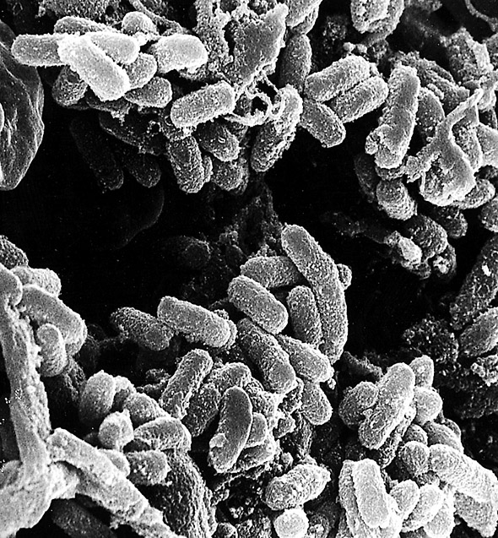
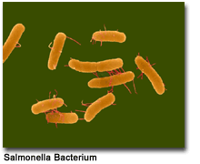
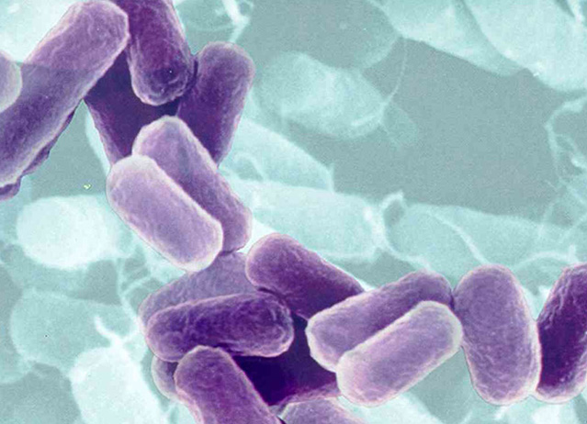
1. Proteobacteria: largest and most diverse group
Usually live in symbiosis with other organisms
2. Gram-pos/neg bacteria: this is a very large group
Contains both helpful and harmful bacteria

Slide 10
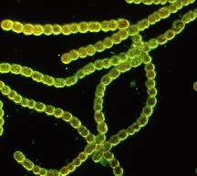
3. Cyanobacteria: are photosynthetic
They were Earth’s first photosynthetic organisms
Major source of food for aquatic animals
4. Spirochetes: strangely shaped bacteria that sometimes cause disease (usually diarrhea)

Slide 11
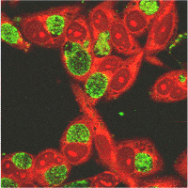
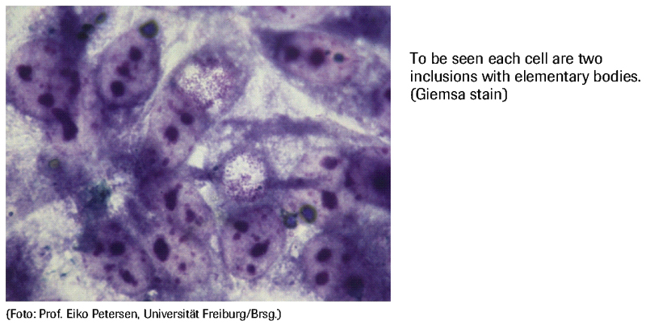
5. Chlamydia: must live within animals cells - can not live on own (parasitic)

