Slide 1
Chapter objective
4. Explain how viruses reproduce

Slide 2
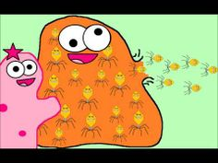
Viruses reproduce through a process called: replication
Outside the body, a virus is a lifeless particle with no control of its movements (air, water, food, body fluids)
But if they gain entry to a host cell, they take over the cell and force it to make more viruses
When the cell is too full of viruses, it bursts and the viruses are free to infect a new host cell

Slide 3
There are 4 steps to viral replication:
Attachment – specific proteins on cell surface attach to virus
Insertion – the virus injects its nucleic acid into the targeted cell
Biosynthesis – the virus nucleic acid enter the nucleus of the cell and take over, forcing the cell to make new viruses
Release – the cell continues to make viruses until it bursts, releasing the new viruses to invade new cells
https://www.youtube.com/watch?v=Rpj0emEGShQ

Slide 4
Chapter Objective:
5. Identify diseases caused by viruses

Slide 5
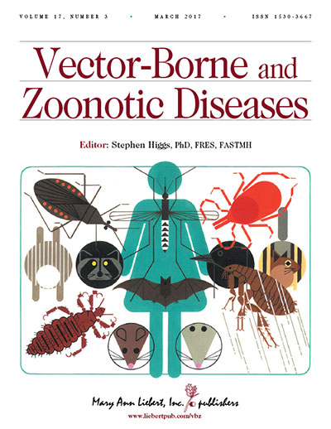
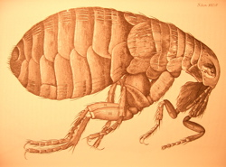
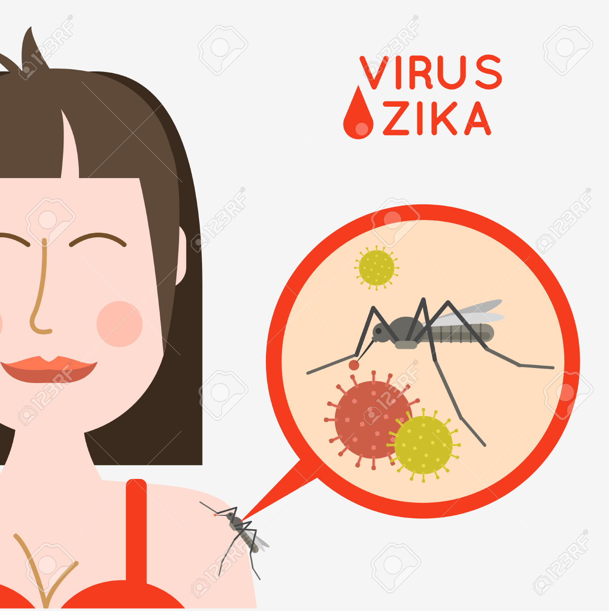
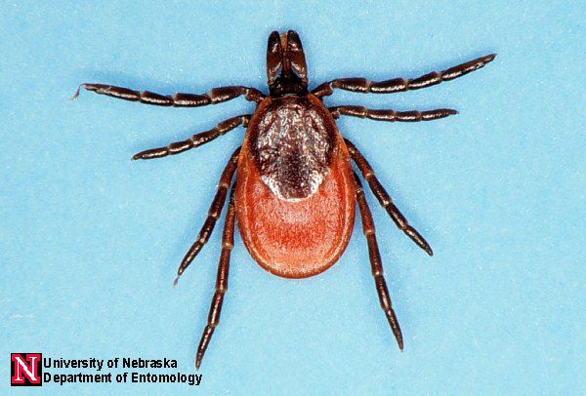
Viruses that cause human disease are transferred to us through a vector
A vector is an intermediate host that transfers a virus from one organism to another
Vectors can be living: mosquitos, ticks, fleas, humans, animals
Vectors can also be non-living like food, water and air

Slide 6
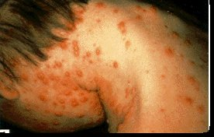
Chickenpox & Shingles: virus multiplies in the lungs & then moves to the blood vessels of the skin causing a rash (vector: air)
Hepatitis: 5 different viruses can cause an infection of the liver that can be life threatening (vector: varies)
AIDS: Human ImmunoVirus (HIV) attacks the white blood cells that provide immunity to simple diseases (vector: bodily fluids)

Slide 7
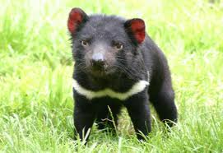
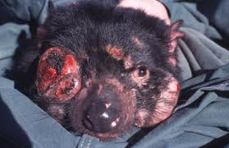
Cancer: can be caused by viruses when the virus permanently damages the reproductive timing of the cell
Cancer is a group of cells that reproduce at an increased rate
HPV: (human papilloma virus) causes cervical cancer in women
Vector: Sexual Contact

Slide 8
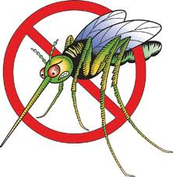
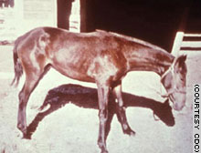
West Nile Disease: Causes fever, headache, coma, paralysis (vector: mosquitos)
Mostly found in birds, but has now MUTATED & infects mammals, including humans!

Slide 9
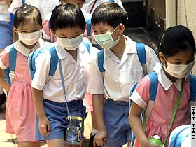
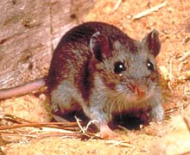
SARS: (Severe Acute Respiratory Syndrome)
Highly contagious
Symptoms like pneumonia
Highly fatal
Vector: air
Hantavirus: mostly in SW United States
Causes pneumonia
Highly fatal
Vector: rodents

Slide 10
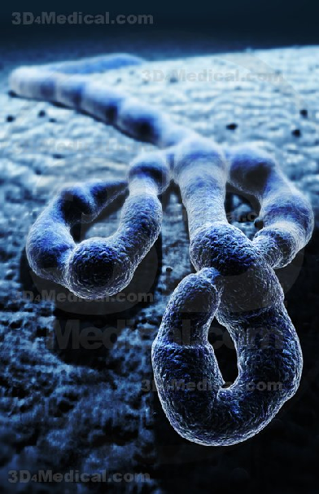
Ebola: highly fatal, hemorrhagic fever
Causes high fever, vomiting, internal bleeding & circulatory collapse
Central African rain forests
Increasing in occurrence because of rain forest destruction
(vector: air)

