Slide 1
Chapter objective
6. How to control viral infections

Slide 2
Outside the body, they are easily destroyed by bleach and other disinfectant cleaners – handwashing is the best method to contain a viral outbreak
Inside the body, it is a different story:
Antibiotics will not work as they only work by disrupting the metabolism of living things (& viruses are not alive)

Slide 3
Antiviral drugs: interfere with the replication of viruses
Interferon – help to boost the cells ability to fight off viral attacks
Vaccines – help prevent us from getting a viral disease by boosting our immune system, allowing our immune system to dismantle a virus before it has a chance to attack

Slide 4
Protease inhibitors – interfere with the viral capsid. If a virus has a damaged capsid, it cannot protect it’s nucleic acid and therefore becomes inactive
Plants that are infected by viruses must be burned in order to control the spread of virus

Slide 5
Chapter objective
7. Explore viroids and prions

Slide 6
Until recently, viruses were the smallest disease causing particles, but now we have…Viroids & prions
Viroids: made up of only a circular strand of nucleic acid (DNA or RNA)
Infect mostly plants (right now)
Prions: infective proteins
These abnormal proteins have the capability to transform normal proteins into the abnormal prions
Causes many brain related diseases:

Slide 7
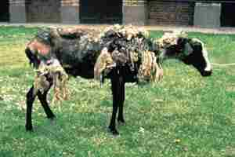
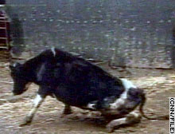
BSE: (Bovine spongiform encephalitis) a.k.a. Mad Cow disease
Scrapie: sheep scrape their wool off

Slide 8
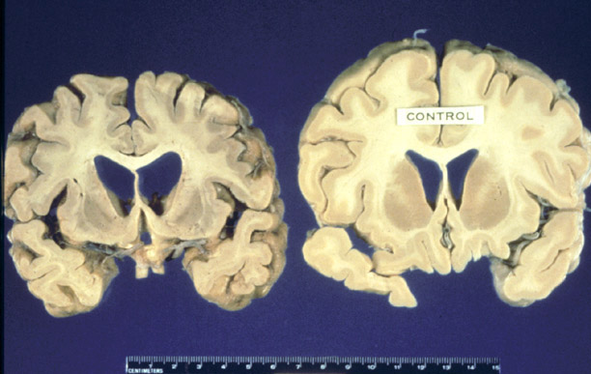
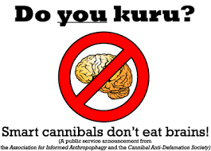
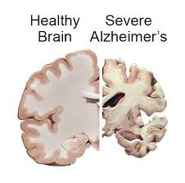
CJD: (Creutzfeldt-Jakob disease) in humans – similar to Alzheimers
Kuru: in humans
Alzheimers?????? Being studied now

Slide 9
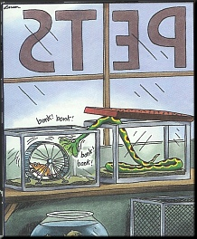
The End!

